Slide 1
Project Management
Instructor: Mehroze Khan

Slide 2

Customer Questions
Customers have several questions to be answered:
Do you understand my problem and my needs?
Can you design a system that will solve my problem or satisfy my needs?
How long will it take you to develop such a system?
How much will it cost to have you develop such a system?

Slide 3
Project Schedule
A project schedule:
Describes the software development cycle for a particular project by enumerating the phases or stages of the project and breaking each into discrete tasks or activities to be done.
Portrays the interactions among these activities and estimates the time that each task or activity will take.
Is a timeline that shows when activities will begin and end, and when the related development products will be ready.

Slide 4
Project Schedule
We begin by working with customers and potential users to understand what they want and need. At the same time, we make sure that they are comfortable with our knowledge of their needs. We list all project deliverables, that is, the items that the customer expects to see during project development.
Among the deliverables may be:
Documents
Demonstrations of function
Demonstrations of subsystems
Demonstrations of accuracy
Demonstrations of reliability, security, or performance

Slide 5
Project Schedule
An activity is a part of the project that takes place over a period of time.
A milestone is the completion of an activity—a particular point in time.
We can describe each activity with four parameters:
A precursor is an event or set of events that must occur before the activity can begin; it describes the set of conditions that allows the activity to begin.
The duration is the length of time needed to complete the activity.
The due date is the date by which the activity must be completed, frequently determined by contractual deadlines.
Signifying that the activity has ended, the endpoint is usually a milestone or deliverable.

Slide 6
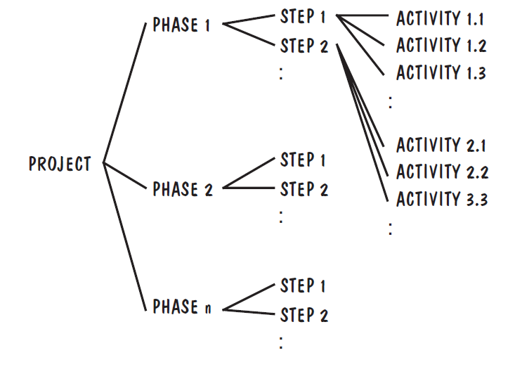
Project Schedule
We can separate development into a succession of phases. Each phase is composed of steps, and each step can be subdivided further into activities

Slide 7
Work Breakdown Structure
Dividing Complex projects to simpler and manageable tasks is the process identified as Work Breakdown Structure (WBS)
It depicts the project as a set of discrete pieces of work.

Slide 8
Work Breakdown Structure

Slide 9
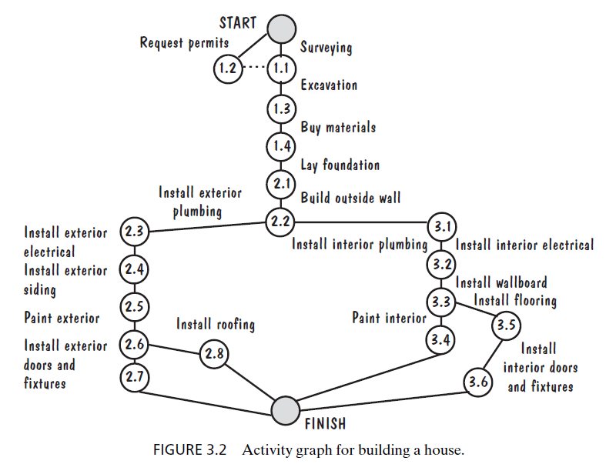
Activity Graph

Slide 10
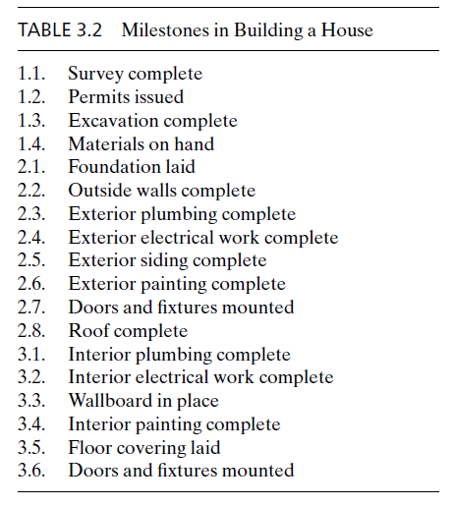
Milestones

Slide 11
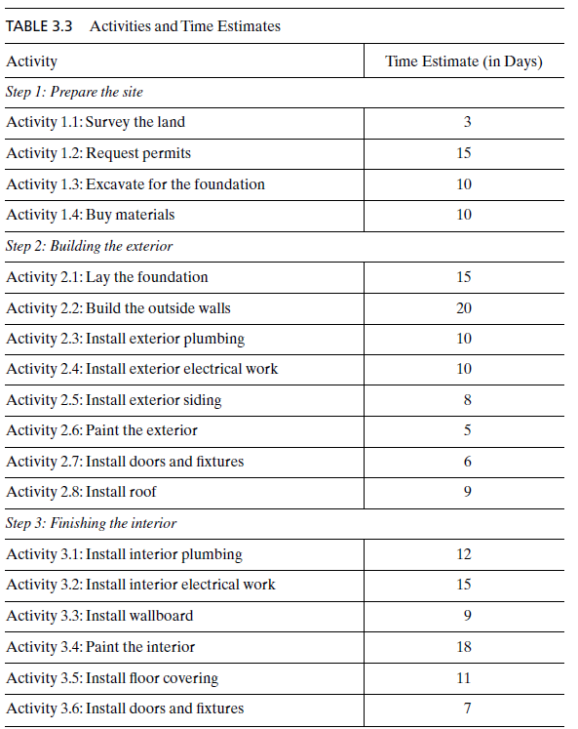
Estimating Completion

Slide 12
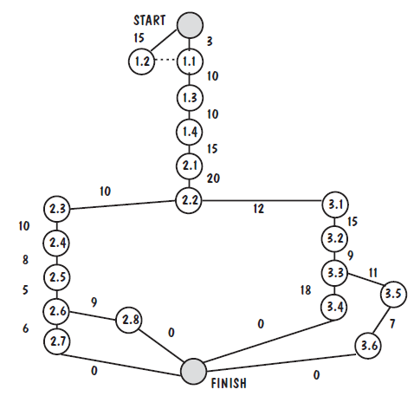
CPM Activity Graph with Time Durations

Slide 13
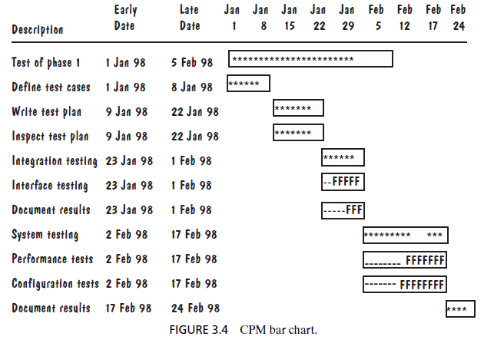
CPM Bar Chart
Notes:
The horizontal bars represent the duration of each activity; those bars composed of asterisks indicate the critical path. Activities depicted by dashes and Fs are not on the critical path, and an F represents float or slack time.

Slide 14
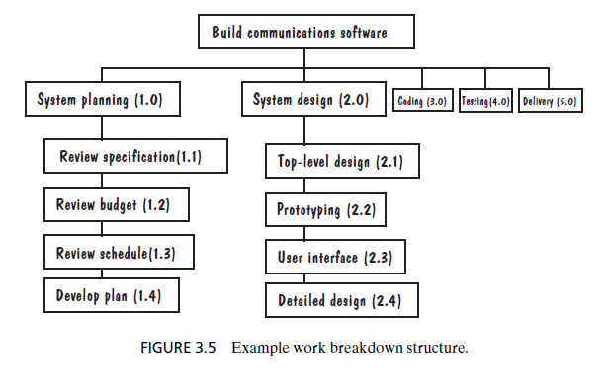
WBS for Communication Software

Slide 15
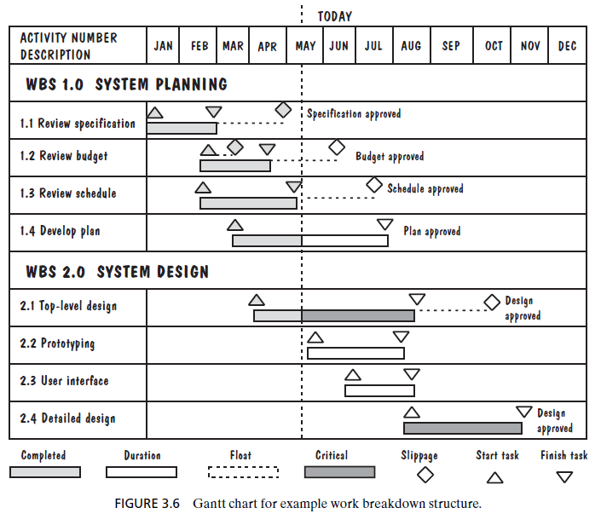
Gantt Chart
Notes:
The project began in January, and the dashed vertical line labeled “today” indicates that the project team is working during the middle of May. A vertical bar shows progress on each activity, and the color of the bar denotes completion, duration, or criticality. A diamond icon shows us where there has been slippage, and the triangles designate an activity’s start and finish.

Slide 16
References
Shari PFleeger, Joanne Atlee, Software Engineering: Theory and Practice, 4th Edition
Roger S. Pressman, Software Engineering A Practitioner’s Approach, 9th Edition. McGrawHill

